Slide 1
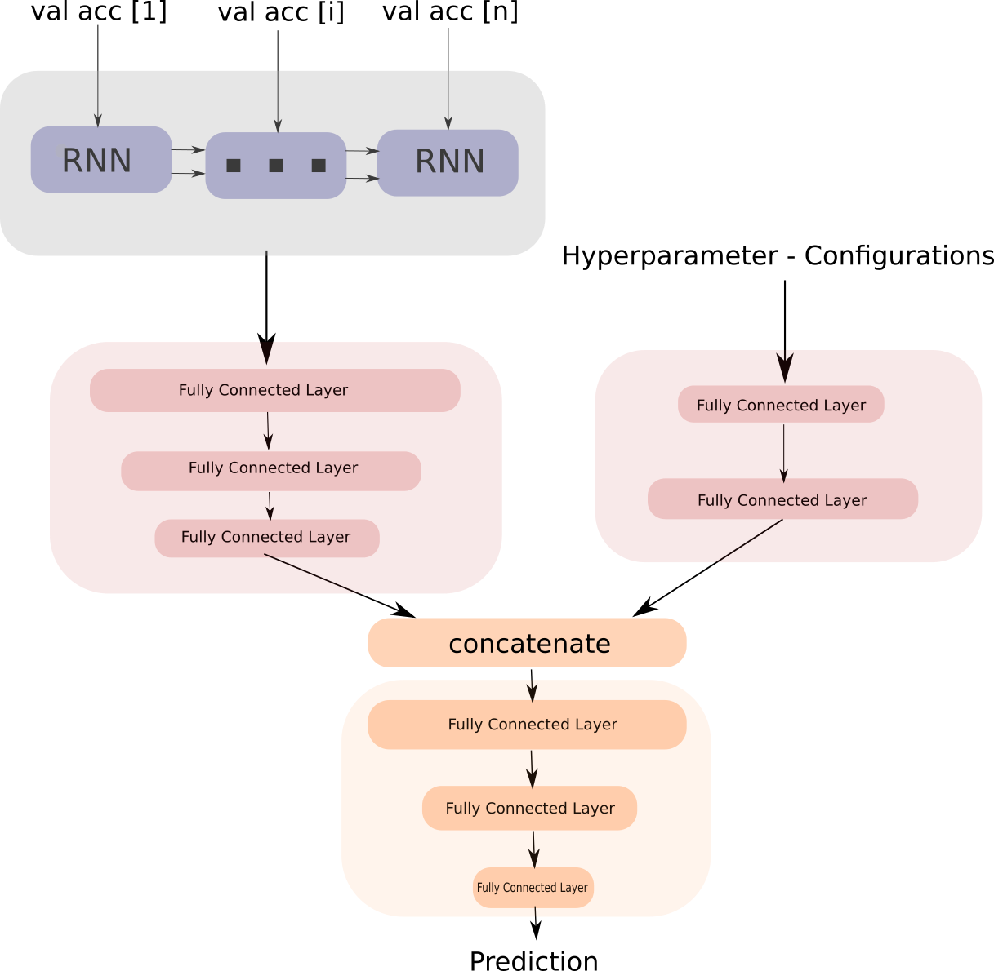
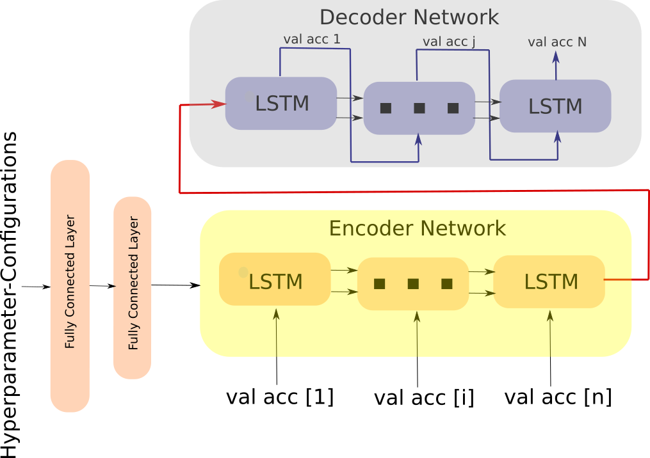
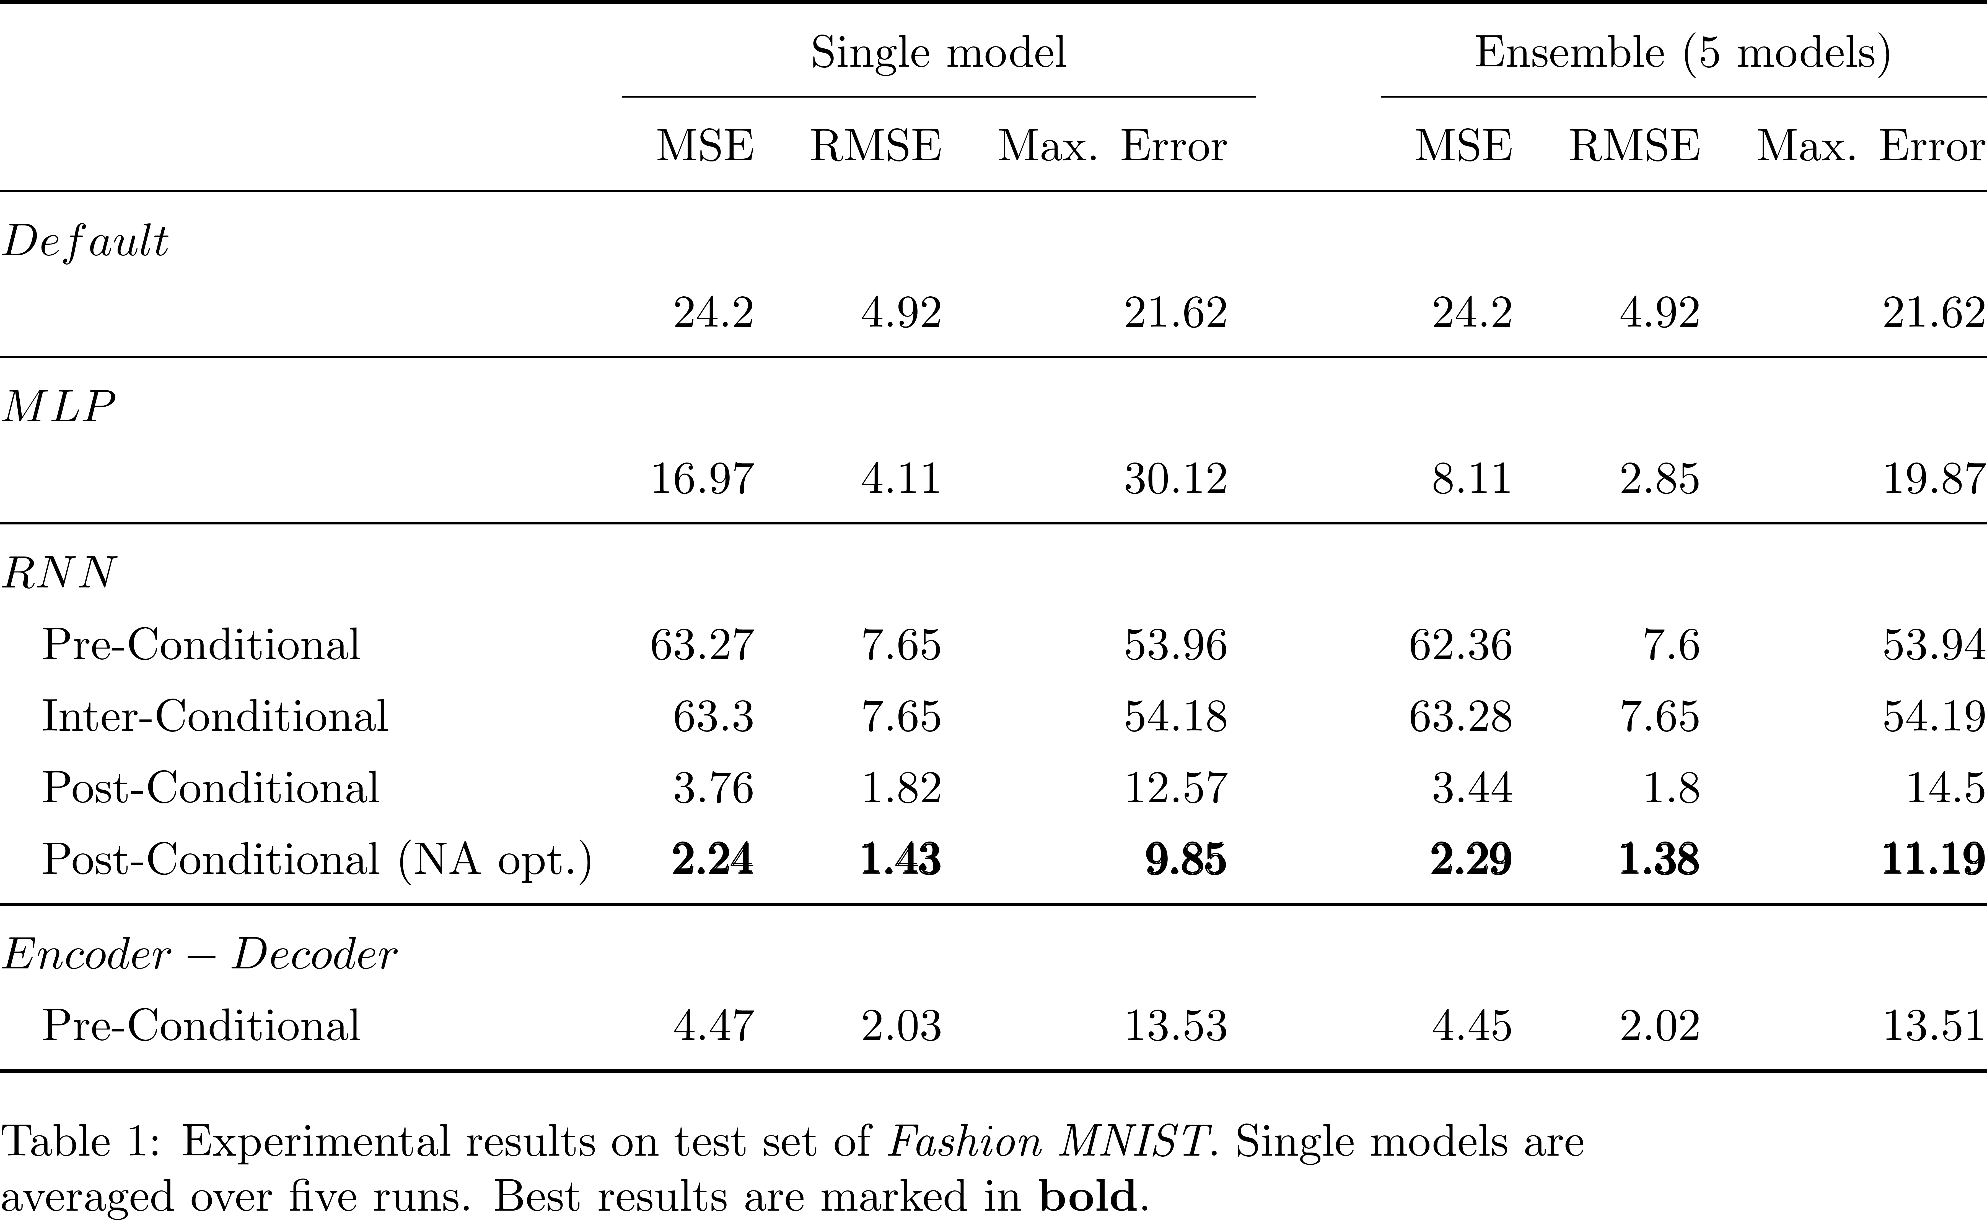
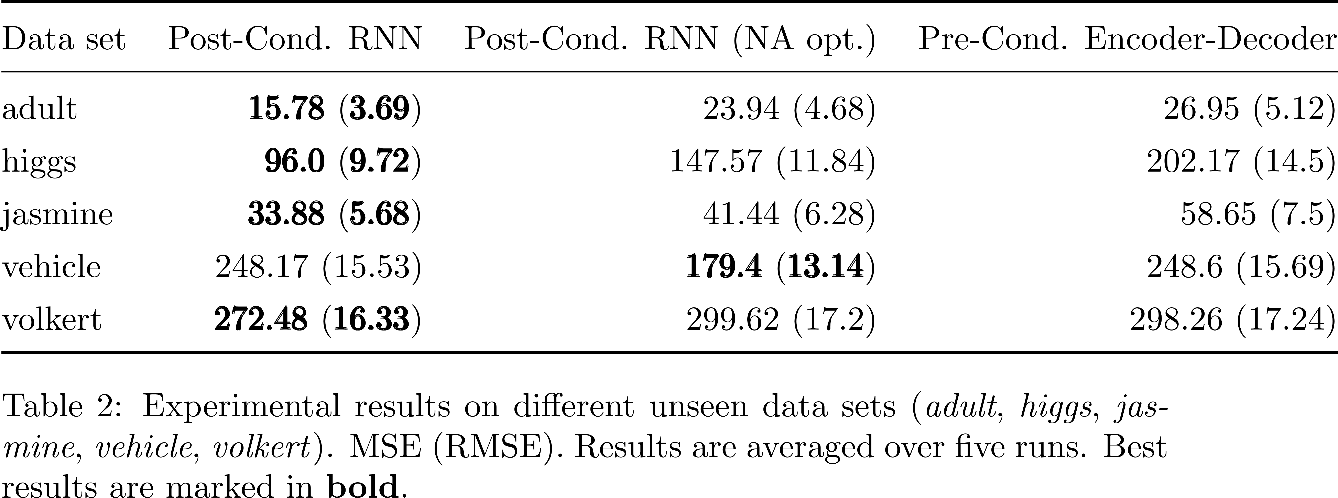
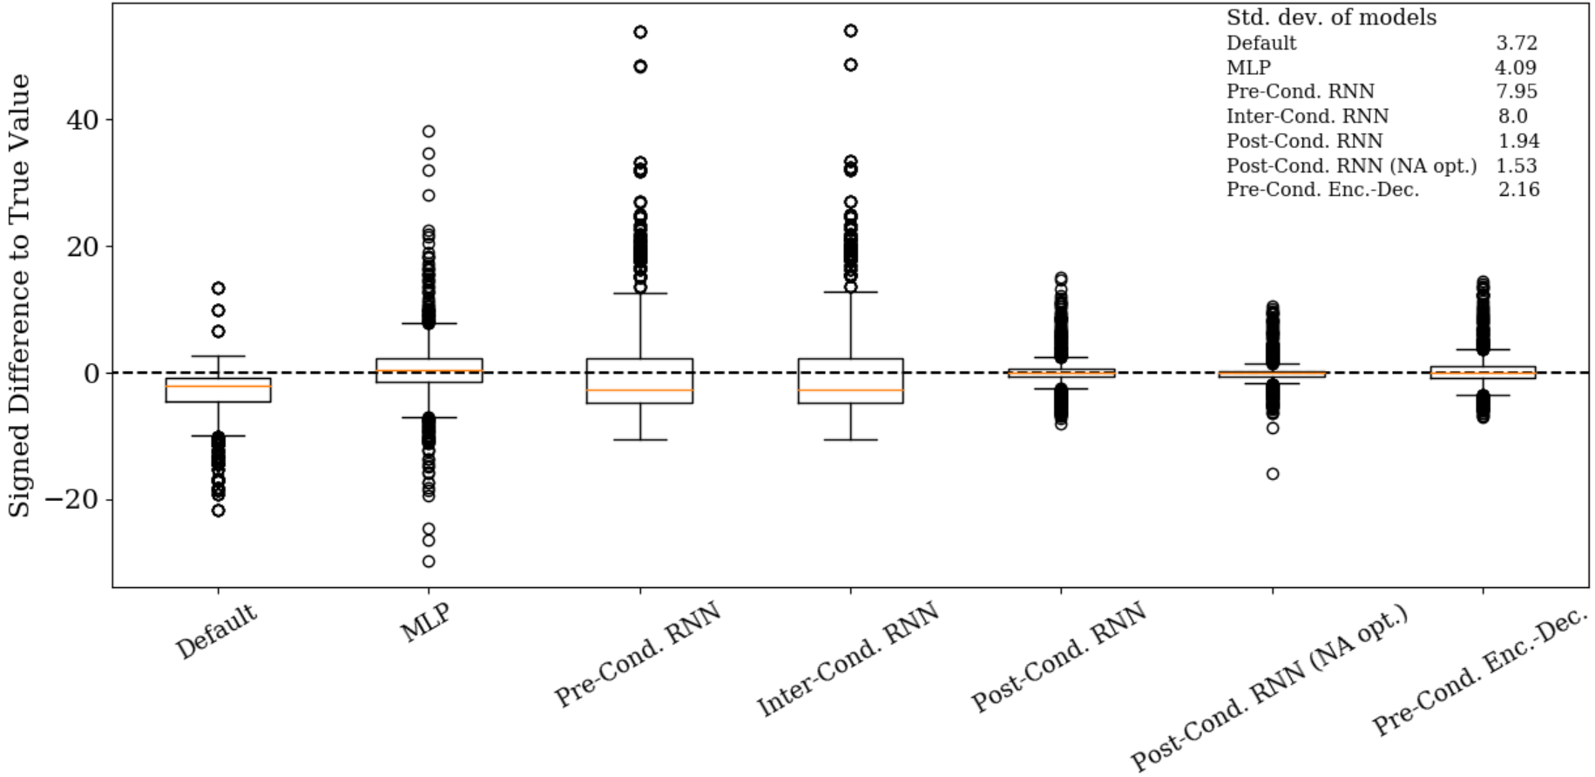
Conditional Learning Curve Model Sven Hauns, Sambit Mohapatra & Simon Schrodi
Project goals
Predict validation accuracy at the end of training
Leverage hyperparameter & sequential data information
Provide reliable predictions (e.g. final validation accuracy or total learning curve)
Related Work
Parametric learning curve models & partially observed learning curve as input (Domhan et al. 2014)
Bayesian Neural Network using only hyperparameters as input (Klein et al. 2017)
Probabilistic Rollouts, treating learning curves as sequential data & using partially observed learning curves and hyperparameters as input (Gargiani et al. 2019)
Architectures
Pre-Conditional Encoder-Decoder RNN
Post-Conditional RNN
Experimental Results
Outlook & Future Work
Improve generalization capability of models (-> transfer learning)
Visualizing relevancies of hyperparameters (-> faster algorithm)
Use of multivariate sequential data input
Estimate upper and lower bounds of validation accuracy

